Slide 1
Data Science-Capstone project
Theme Classification & Keywords Extraction on Review Comment

Slide 2
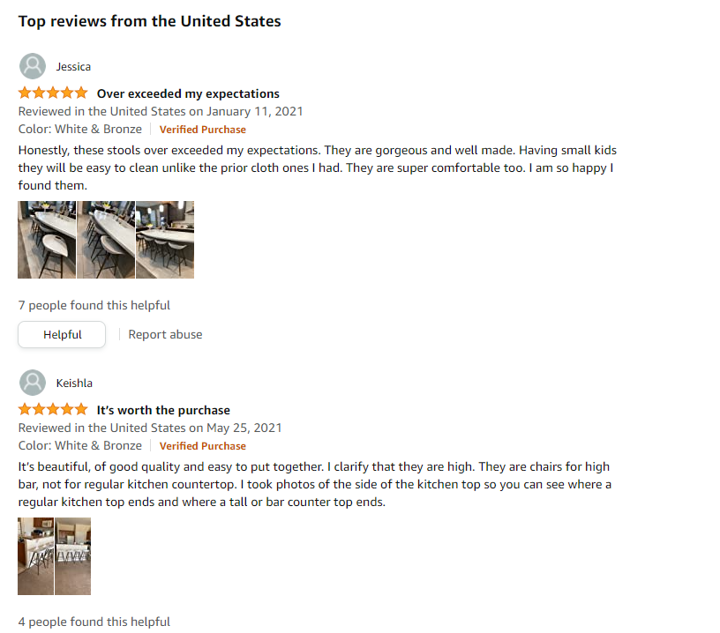

The Problems
What is the problem?
Customer leave a lot of comment
Who has this problem?
Sales team
What business value to solve this problem?
WFH is more popular during Covid-19
Discover foreign market demand and trending
No main topic or theme from website
No keywords
Impossible to study each comment manually
Merchandiser/ Designer
Attract potential customers who rely on comment
Products improvement

Slide 3
Flow
Data Gathering
Customer comment from Amazon.com
Assign label
Data Cleaning/ Massage
Remove duplicate data
ML Modeling
Logistic Regression
SVM
Evaluation
Confusion Matrix
Feature Engineering
XGBoost
Accuracy & f1 score
Example Review
Drop columns
Label Distribution
Data Exploration
Rating for each label
Convert label to numeric
Tokenize
Remove stop words
Lemmatize with pos
BOW
TF-IDF
Keywords Extraction
Theme Classification

Slide 4
Data Gathering

Slide 5
Data Gathering
Data Source:
Customer Review Comment from Amazon.com provided by vendor
Product: Furniture (Office Chair, Sofa, Mattress, Headboard, etc)
from 2017 to 2022 YTD
Label:
Classified comment to 5 themes:
Product Design (Function/ Comfortability/ Material)
Durability
Assembly or Installation
Pricing/ Value of Money
Shipping/ Logistic/ Packaging

Slide 6
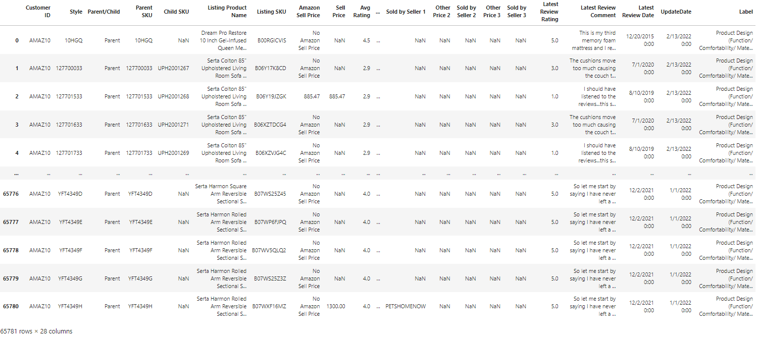
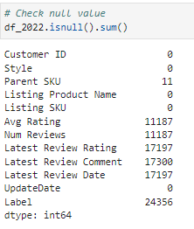
Raw Data
Data shape = 65,781 rows x 28 columns
Duplicate Data
Null comment
Unnecessary columns

Slide 7
Data Cleaning

Slide 8
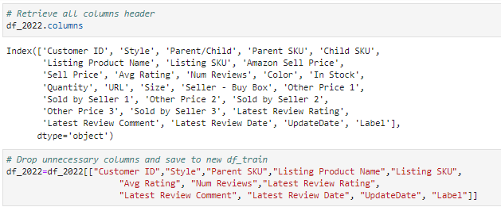
Drop columns
Drop all unnecessary columns
Pricing columns, product variant columns
From 28 columns to 12 columns
Save space

Slide 9
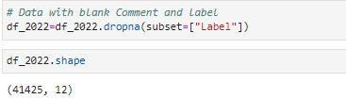
Remove blank label
Remove data with blank label
Blank label = blank comment or comment cannot be classified
41,425 rows (65,781 – 24,356)

Slide 10
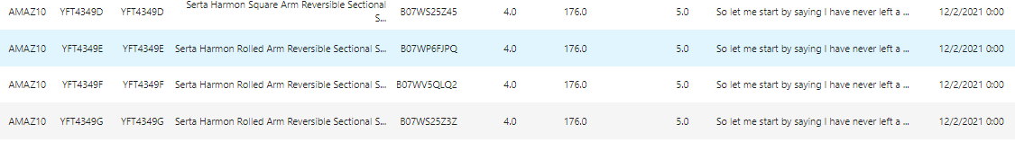
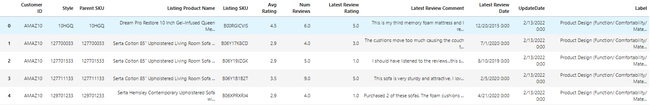
Remove duplicate
Remove all duplicate record
Scrape latest comment snapshot daily
Products with variant (color & size) is sharing same comment
647 rows left

Slide 11
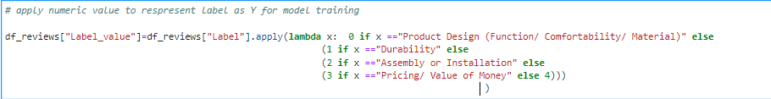
Assign numeric value as y label
Lambda function to assign numeric value for each label
0 = Product Design (Function/ Comfortability/ Material)
1 = Durability
2 = Assembly or Installation
3 = Pricing/ Value of Money
4 = Shipping/ Logistic/ Packaging

Slide 12
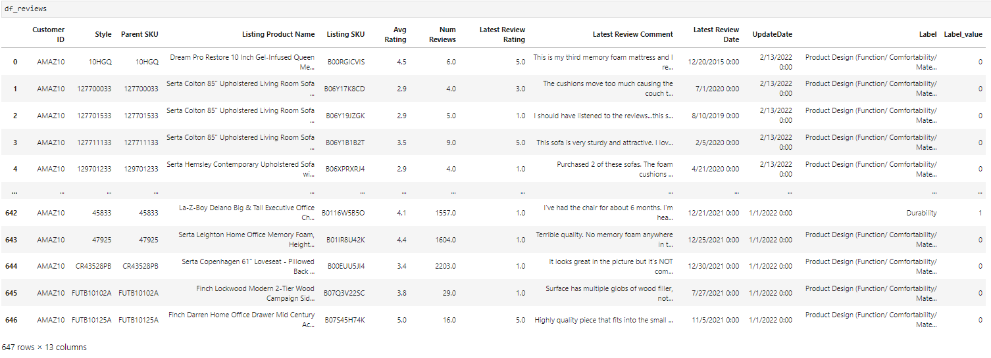
Data set after massage
647 rows x 13 columns
Notice data may not enough

Slide 13
Data Exploration

Slide 14
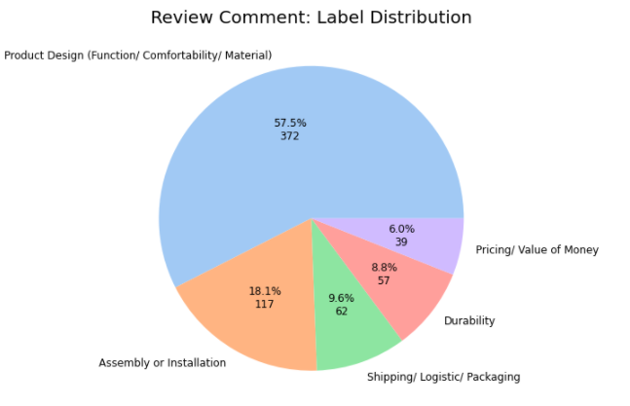
Imbalance Distribution
Majority comment related to Product Design
<20% related to Assembly or Installation
Rest <10% respective

Slide 15
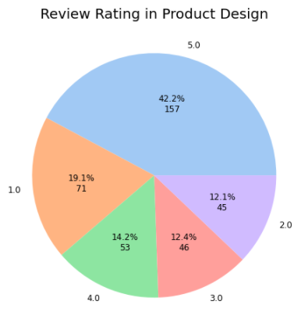
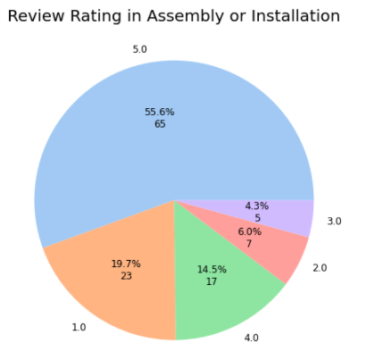
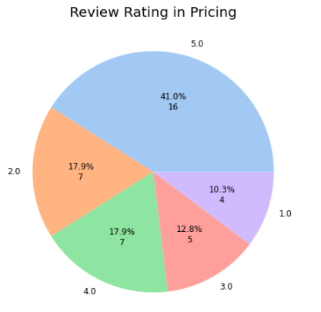
Data Exploration
Customer is satisfied in “Product Design”, “Assembly”, “Pricing”
~60% rated 4 or 5 stars
What is the “good point” ?
Feature for new product or improvement for existing products?

Slide 16
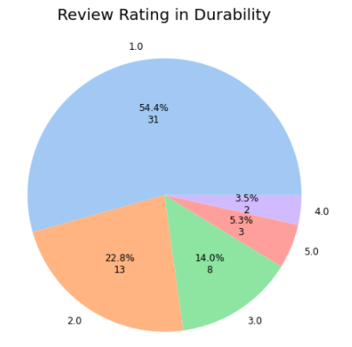
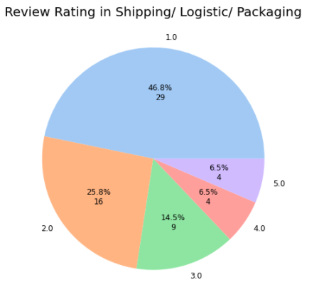
Data Exploration
Customer is dissatisfied in “Durability”, “Shipping/ Packing”
>50% rated 1 or 2 stars
What is the problem or issue?

Slide 17
Feature Engineering

Slide 18
Text Processing
Technique for processing Review comment
tokenize
Remove stop words
Lemmatize with pos_tag

Slide 19
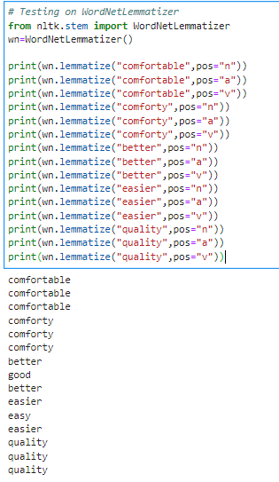
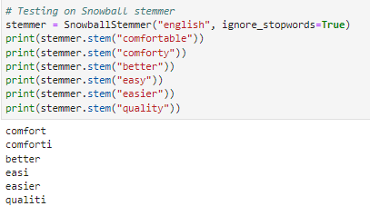
Lemmatizer vs Stemmer
Lemmatizer
Morphological analysis to words
POS may affect the converted word
Keyword is important
Stemmer
cutting suffixes of a word
Often leading to incorrect meanings and spelling

Slide 20
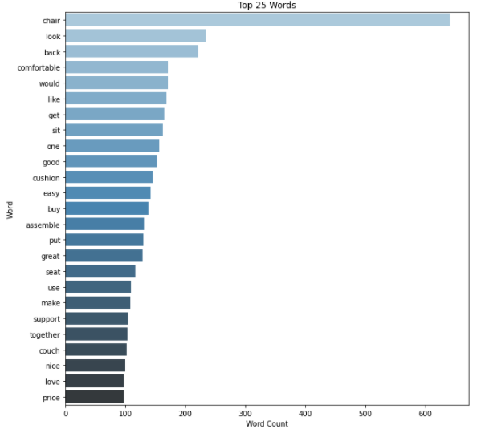
BOW
Understanding the frequent words for all comment (Top 25)
Chair → most products sold in Amazon
Product Design:
look, comfortable, cushion, back, support, sit
Assembly & Installation:
easy, assemble, together
Price/ Value of Money
Price, buy
No keyword for Durability & Shipping
Single wording cannot represent the true story

Slide 21
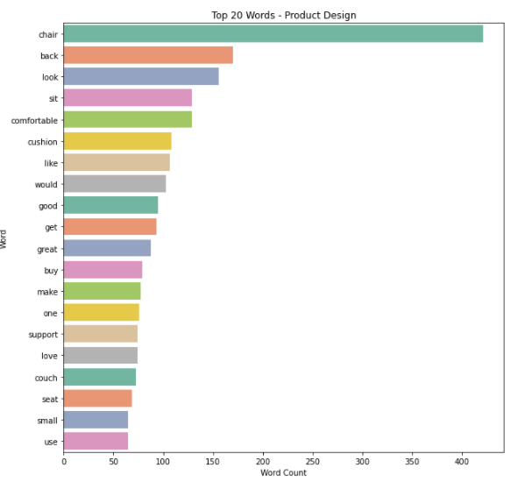
BOW - Product Design
Very similar as it take up near 60% comment
back
sit
comfortable
cushion
New key words
small
seat
Guess:
Level of comfortable
Outlooking
Size

Slide 22
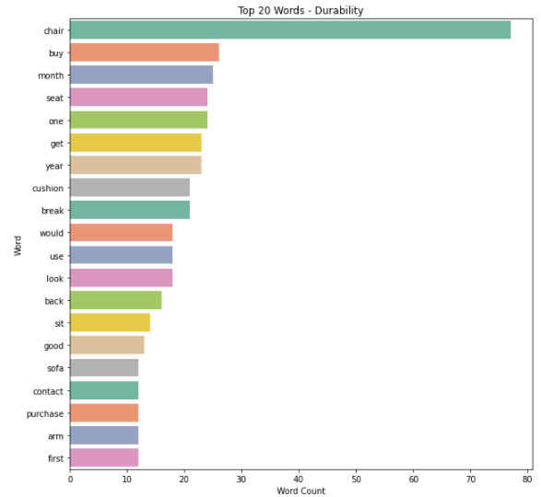
BOW - Durability
Key words related to time or period
month
one
year
Key words for product
break
arm
Guess:
break within a short period
Issue on the product arm

Slide 23
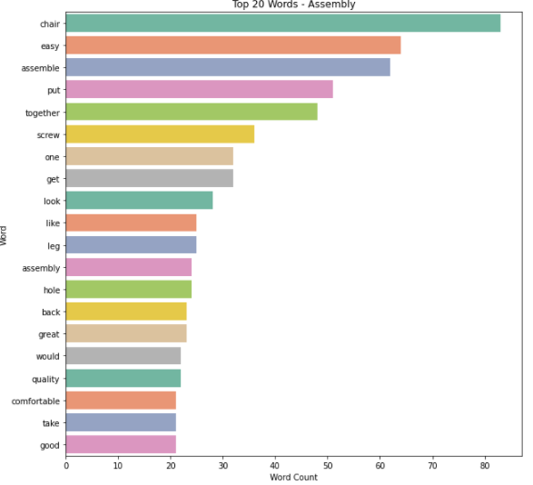
BOW - Assembly
Key words
easy
assemble
screw
hole
leg
Guess:
easy to assemble is key highlight
Issue on screw & hole alignment
Issue on leg part

Slide 24
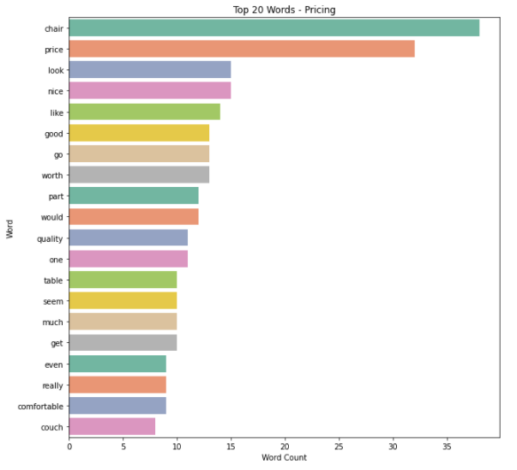
BOW – Pricing/ Value
Key words
price
worth
quality
No key words on price is too high or too low
Guess:
Price worth or not worth quality

Slide 25
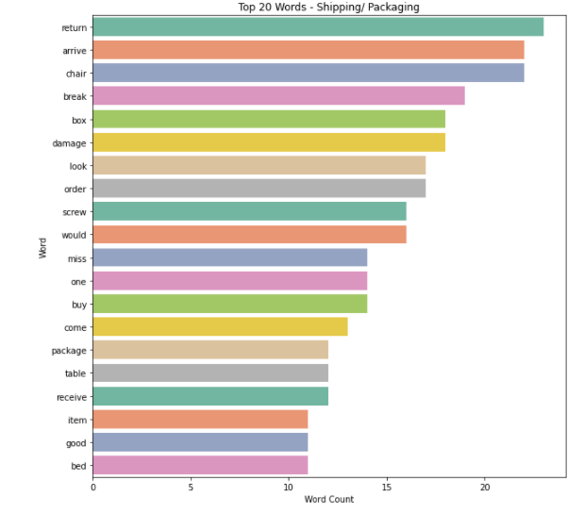
BOW - Shipping/ Logistic/ Packaging
Shipping key words:
arrive, miss, come
Packaging key words:
box, damage, break, package
Guess:
Product arrive on time or late
Missing box or parts
Package is broken when arrive

Slide 26
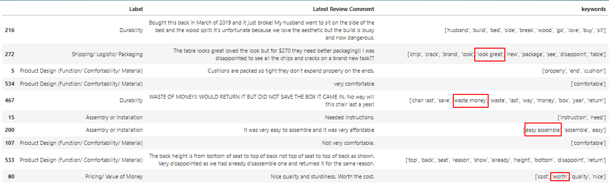
TF-IDF – Key words extraction
Prepare features for each comment for theme classification
Extract key words for each comment
BOW: Basic understanding on key words
TF-IDF: ngram_range=(1,2) to extract key words for each comment
unigrams : one-word sequence
bigrams : two-word sequence

Slide 27
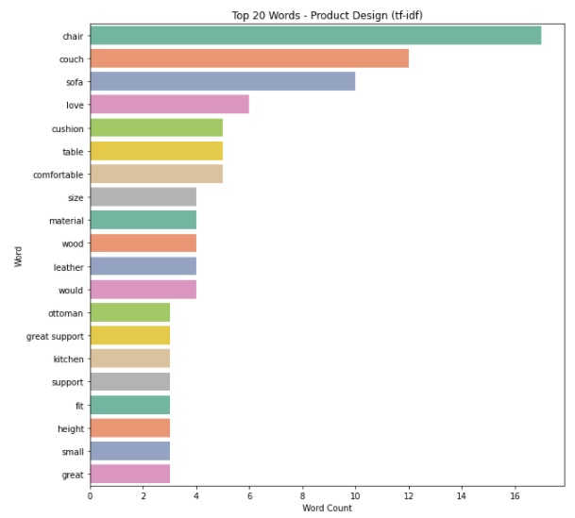
Tf-idf - Product Design
Keywords
couch
cushion
comfortable
Great support
New key words
small
Material; wood; leather
Similar guess as BOW
Level of comfortable
Outlooking
Size
Added material

Slide 28
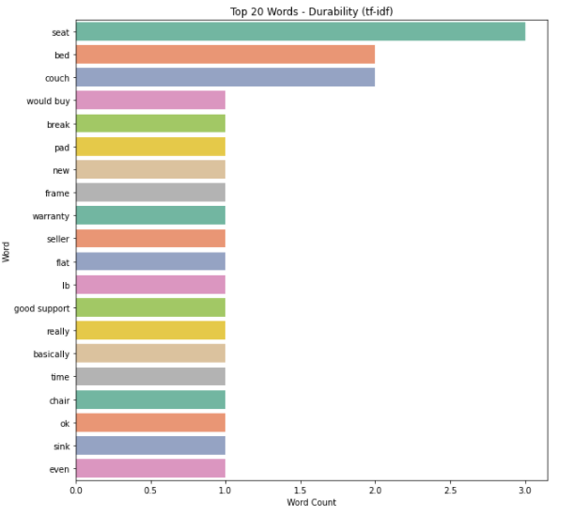
Tf-idf - Durability
Key words
break
Seat
Bed
Frame
warranty
Same Guess:
break within a short period
Issue on the product arm
Related to bed

Slide 29
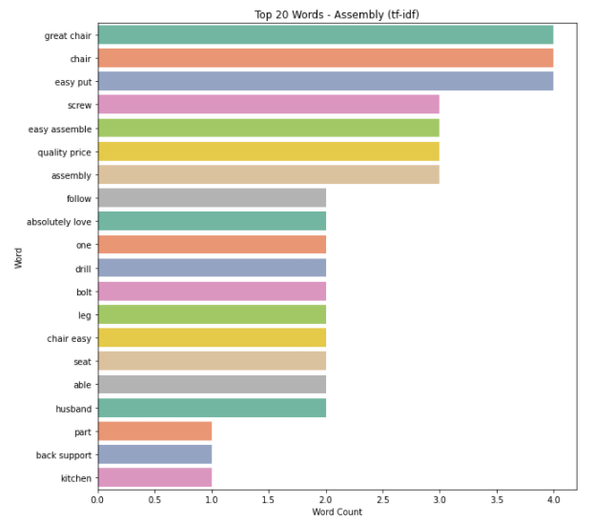
Tf-idf - Assembly
Key words
Easy put
assembly
screw
drill
bolt
leg
Guess:
easy to assemble is key highlight
Issue on screw & hole alignment
Issue on leg part

Slide 30
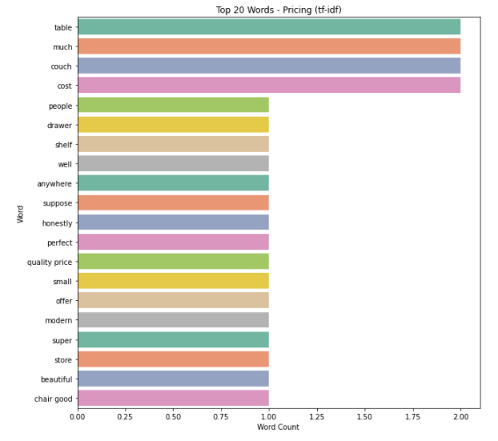
Tf-idf – Pricing/ Value
Key words
cost
Quality price
Much may say on price is too high
Guess:
Price worth or not worth quality

Slide 31
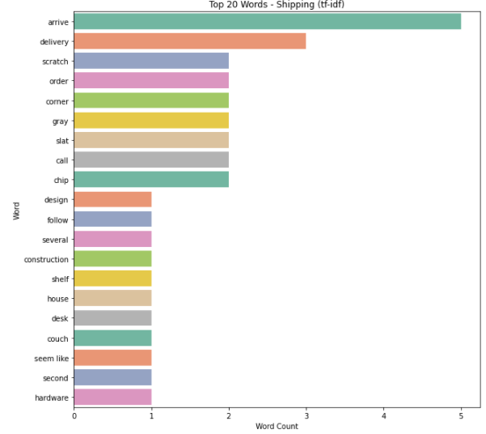
Tf-idf - Shipping/ Logistic/ Packaging
Shipping key words:
arrive, delivery
Packaging key words:
scratch, corner
Guess:
Product arrive on time or late
Damage on package

Slide 32
ML Model – Theme Classifction

Slide 33
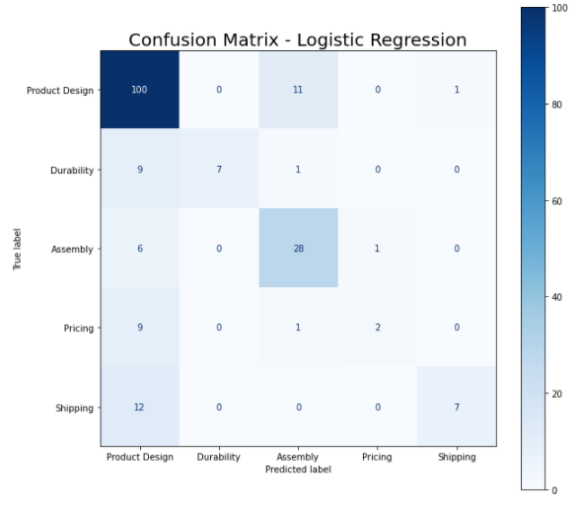

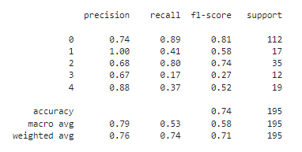
Logistic Regression – 1st attempt
Model Parameter: 'C': 5, 'max_iter': 30, 'penalty': 'l2', 'solver': 'newton-cg’
Overfitting: 98% vs 74% accuracy
Good prediction: Product Design & Assembly
<50% correct: Durability & Shipping
Terrible prediction: Pricing

Slide 34
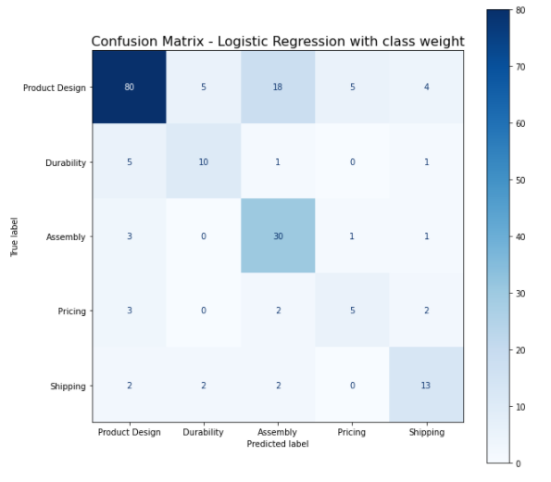

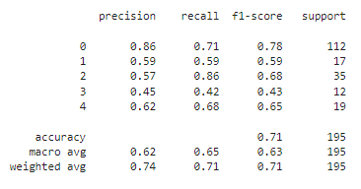
Logistic Regression – Class Weight
Add class weight to model parameter:
'C': 3,'class_weight': 'balanced','max_iter': 30,'penalty': 'l2',’solver': 'newton-cg’}
Overfitting: 94% vs 71% accuracy
Trade off:
Lower accuracy: Product Design
Higher accuracy: All other labels
Pricing is still <50% accuracy
Class weight improve performance

Slide 35
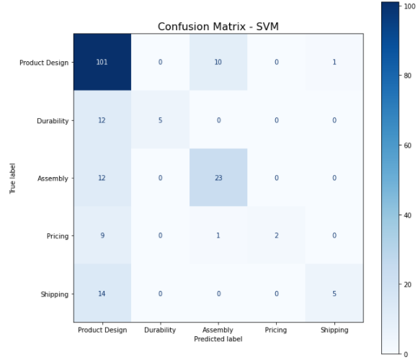

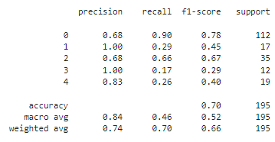
SVM – Class Weight
Model Parameter:
{'C': 1,'class_weight': 'balanced','gamma': 'scale','kernel': 'rbf','max_iter': 300
Overfitting: 98% vs 70% accuracy
Only good prediction on Product Design

Slide 36
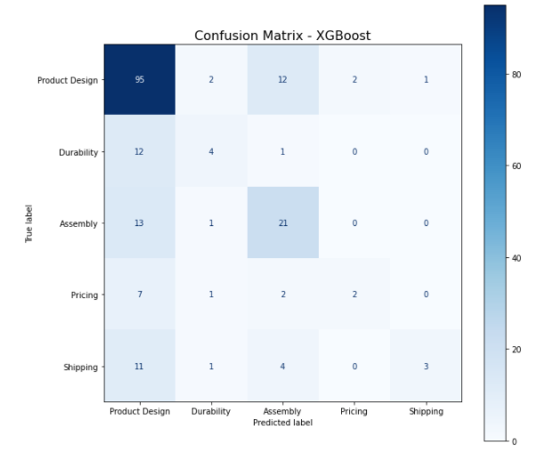
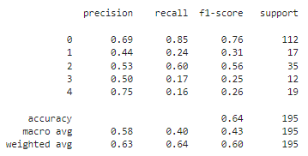
XGBoost
Model Parameter:
'booster': 'gbtree', 'eta': 1, 'gamma': 0, 'max_depth': 10, 'num_class': 5, 'objective': 'multi:softmax’
Overfitting: 100% vs 71% accuracy
Good prediction:
Product Design & Assembly
Poor prediction:
Durability & Pricing & Shipping

Slide 37
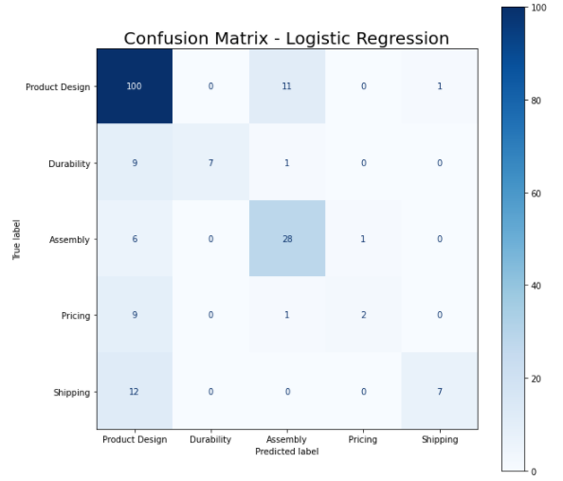
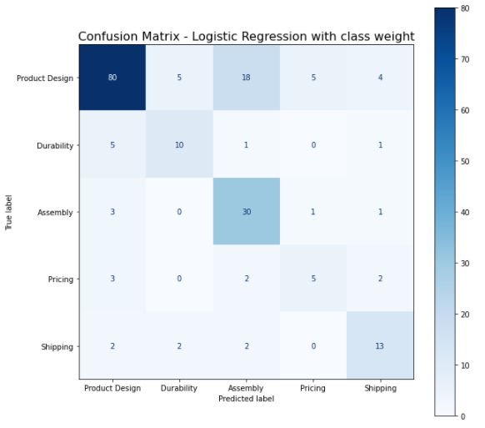
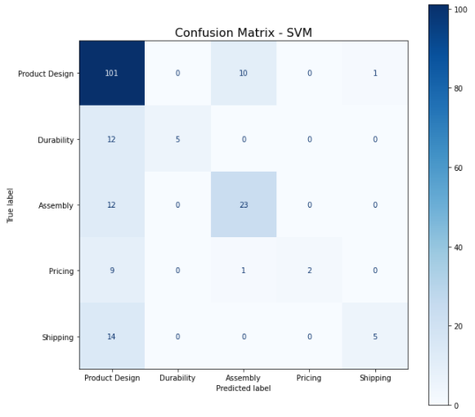
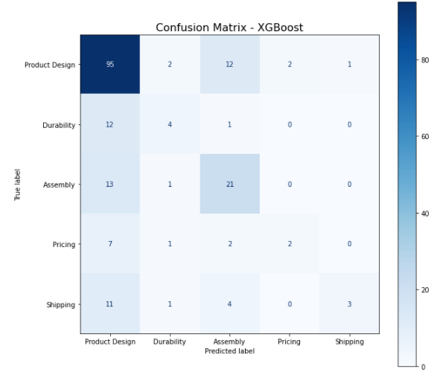
Model Evaluation
Logistic Regression with class weight
Most balanced prediction for all label
All model are overfit
Accuracy score around 70%
insufficient n size for 4 labels
Insufficient keywords for 4 labels
Imbalance data
Difference keywords in train/test data
# of X train Keywords= 277
# of X test Keywords = 153
Only 89 keywords in both dataset, only 32.1%
188 keywords are different word

Slide 38
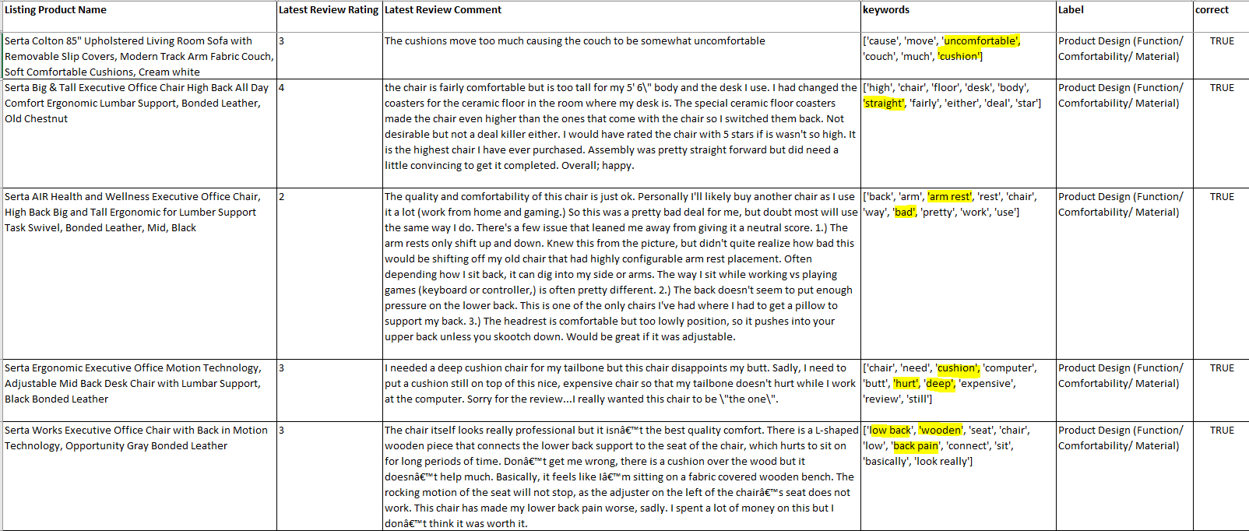
Model Evaluation – Correct Prediction
Product Design (Function/ Comfortability/ Material)

Slide 39
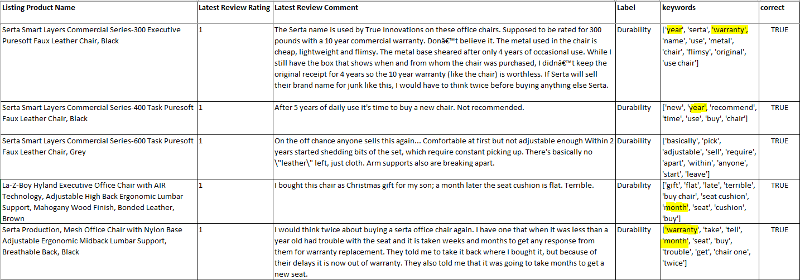
Model Evaluation – Correct Prediction
Durability

Slide 40
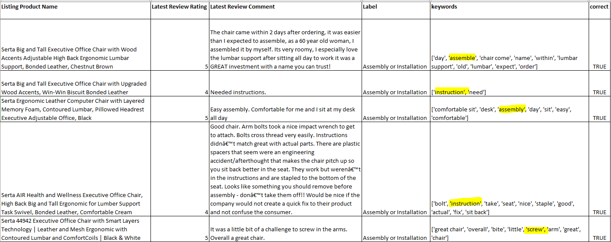
Model Evaluation – Correct Prediction
Assembly or Installation

Slide 41
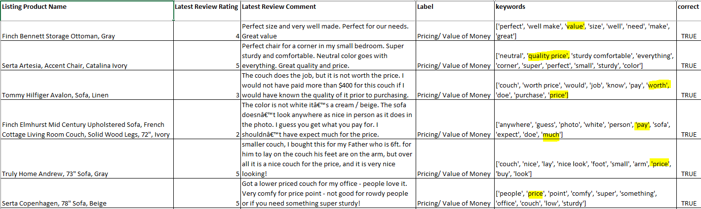
Model Evaluation – Correct Prediction
Pricing/ Value of Money

Slide 42
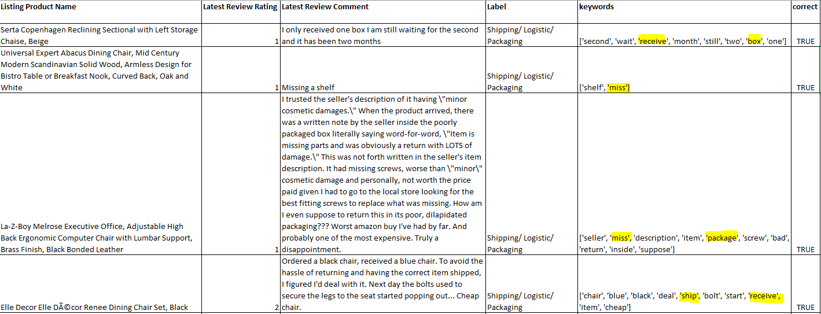
Model Evaluation – Correct Prediction
Shipping/ Logistic/ Packaging

Slide 43
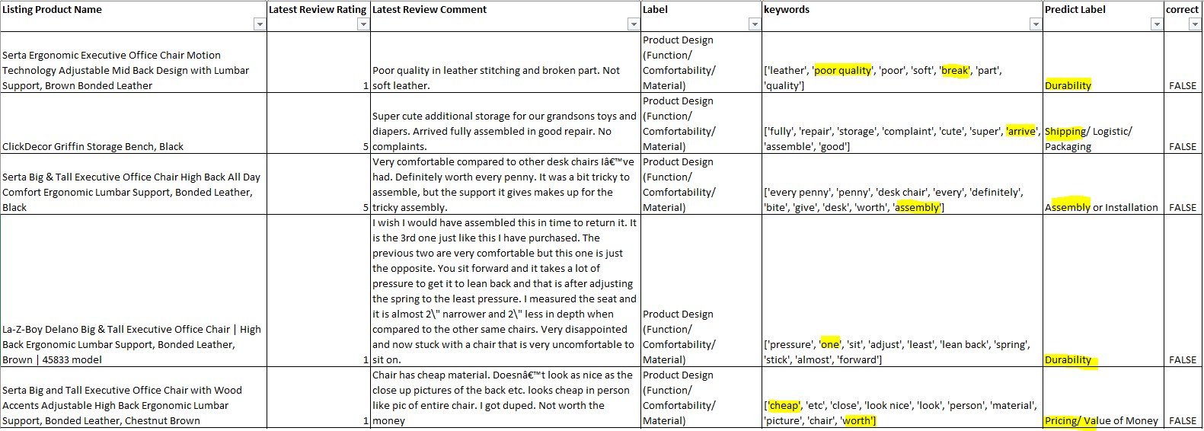
Model Evaluation – Incorrect Prediction
Product Design (Function/ Comfortability/ Material)

Slide 44
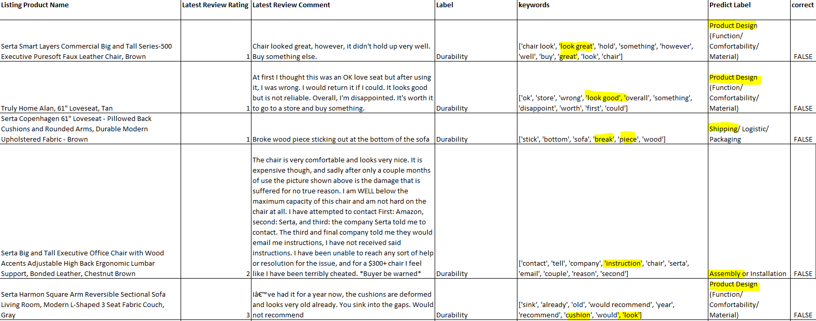
Model Evaluation – Incorrect Prediction
Durability

Slide 45
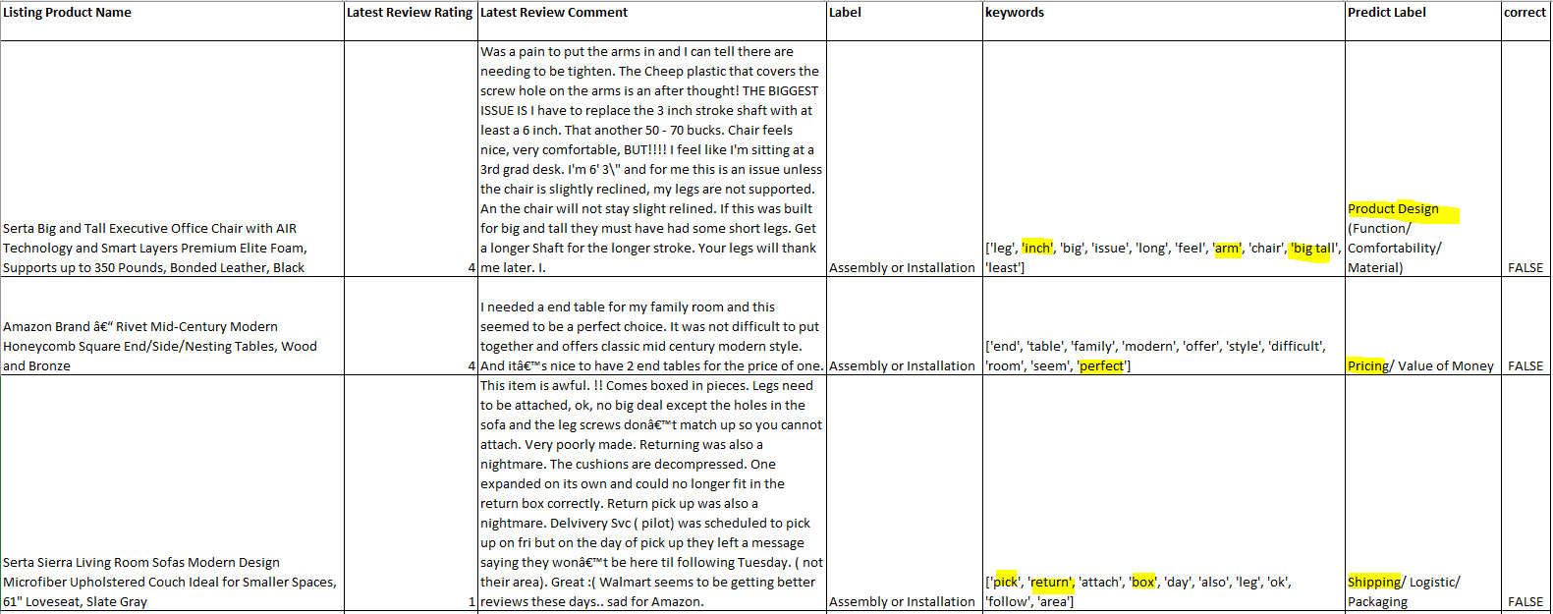
Model Evaluation – Incorrect Prediction
Assembly or Installation

Slide 46
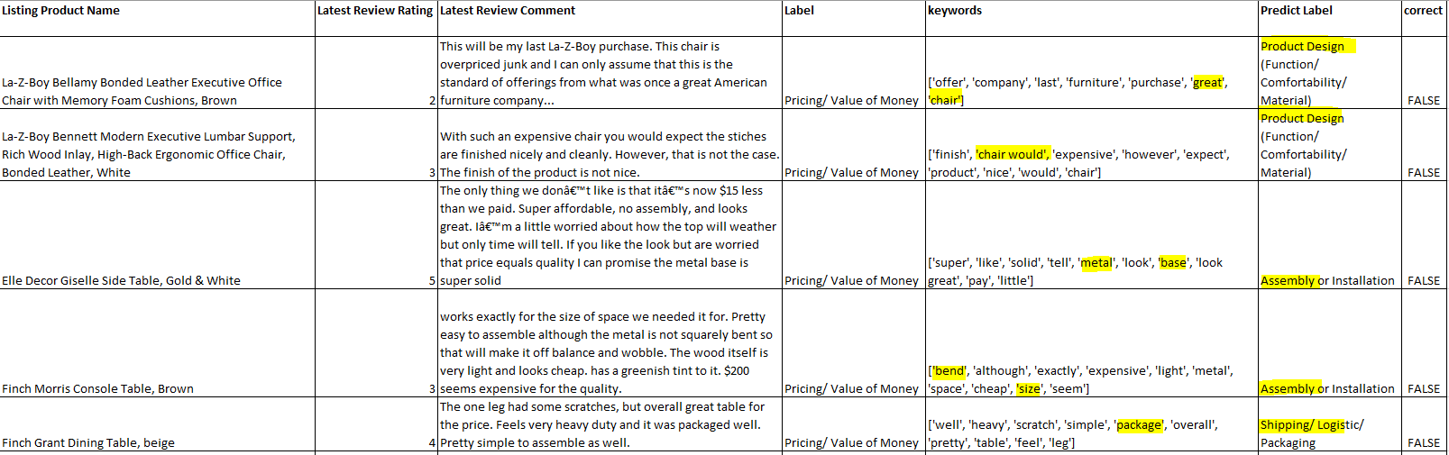
Model Evaluation – Incorrect Prediction
Pricing/ Value of Money

Slide 47

Model Evaluation – Incorrect Prediction
Shipping/ Logistic/ Packaging

Slide 48
Model Evaluation – Incorrect Prediction
Human error when apply Y label
Mixed topic
Key word extraction is not prefect

Slide 49
Can meet business objective?

Slide 50

Product Design (Function/ Comfortability/ Material)
5 Star Rating:
Comfortable
Back support
Shape and outlook

Slide 51

Product Design (Function/ Comfortability/ Material)
1 star rating complain:
Foam/ cushion
Poor sit position
Size

Slide 52

Durability
4-5 Star Rating:
Shape
Outlook like new
Still (long time lasting)

Slide 53

Durability
1 star rating complain:
Break within short period
Feel cheap
QC Control

Slide 54

Assembly or Installation
5 Star Rating:
Easy Assemble is important

Slide 55

Assembly or Installation
1 Star Rating:
Difficult to assemble
Screw and hole

Slide 56

Pricing/ Value of Money
5 Star Rating:
Quality, color or comfortable need to worth price

Slide 57

Pricing/ Value of Mone
1-2 Star Rating:
Cheap material vs price
Poor quality on color or plaint

Slide 58

Shipping/ Logistic/ Packaging
5 Star Rating:
Can accept the box damage when delivery if the product is no damage
Quick CS follow up can help customer experience

Slide 59

Shipping/ Logistic/ Packaging
1 Star Rating:
Missing box or missing piece
Arrive with damage

